Slide 1

montage
for Revit Families

Slide 2
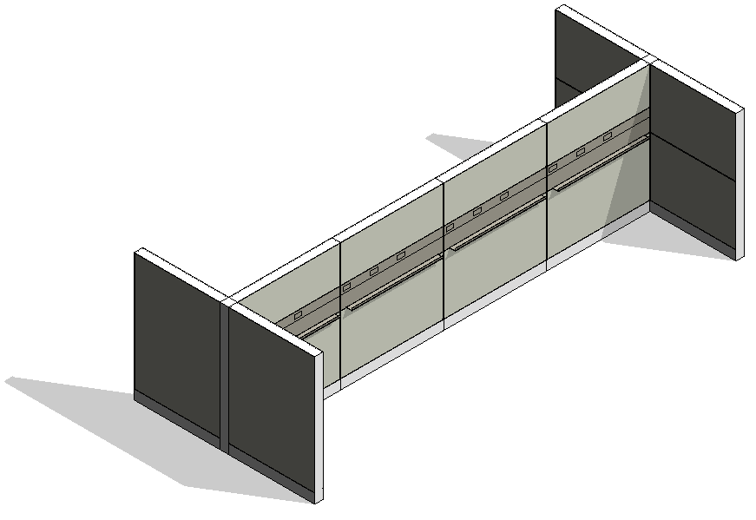
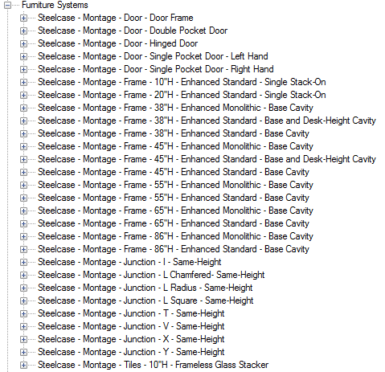
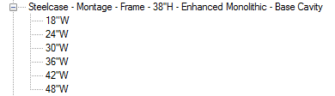
basics
Each height represents 1 family.
Each width represents 1 type.
Intention of the families is to create layouts with nested families instead of of arranging frames and tiles individually.
Style Number only for single items available, not for tiles.

Slide 3
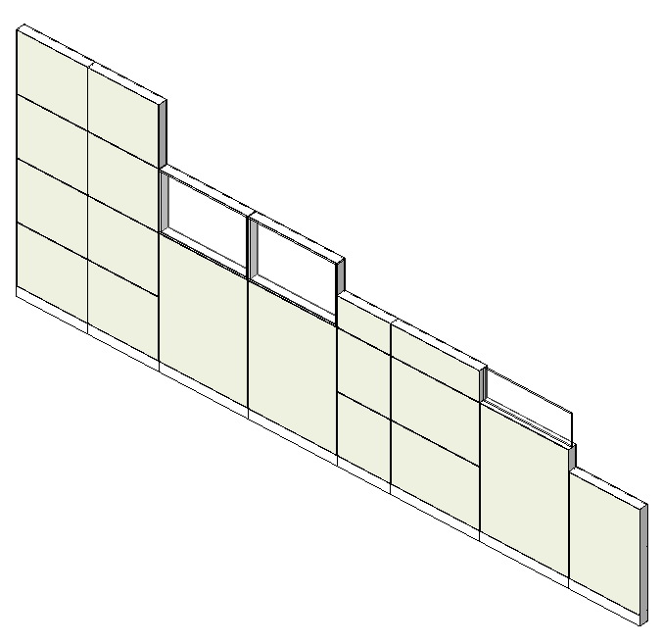
dimensions
Panel Heights
38"H 37.75
45"H 44.75
55"H 55.0625
65"H 65.375
86"H 86.00

Slide 4
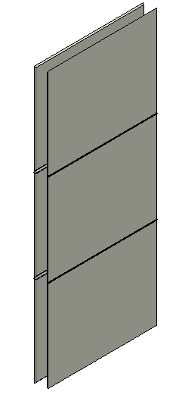
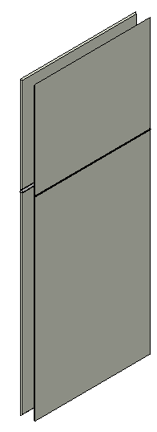
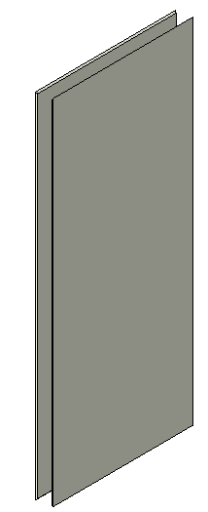
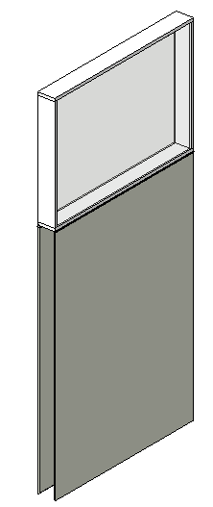
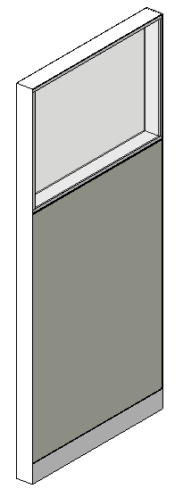
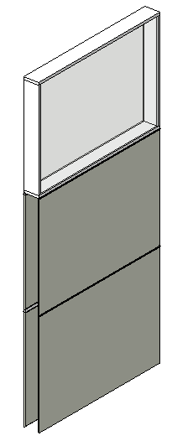
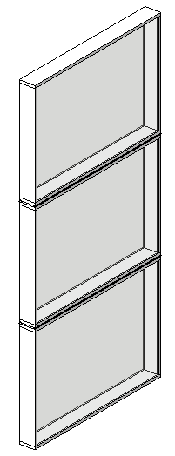
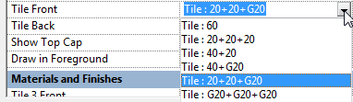
nested families
Sample: Steelcase - Montage - Frame - 65''H - Enhanced Monolithic - Base Cavity
Tile Family
(contains all Tile Arrangements)
20+20+20
40+20
60
40+G20
20+20+G20
G20+G20+G20
(note: ″G ″ stands for Glass Windows)

Slide 5
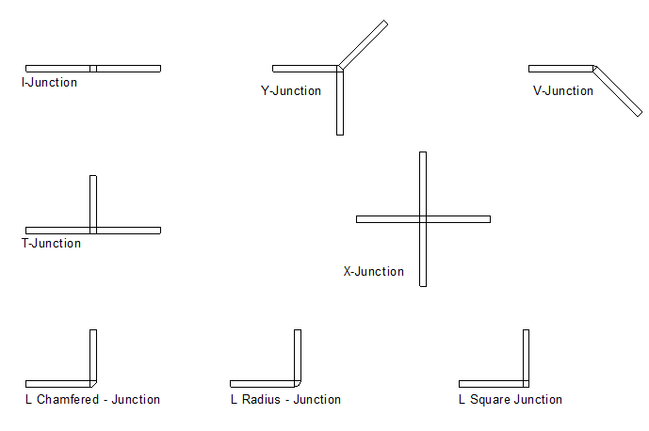
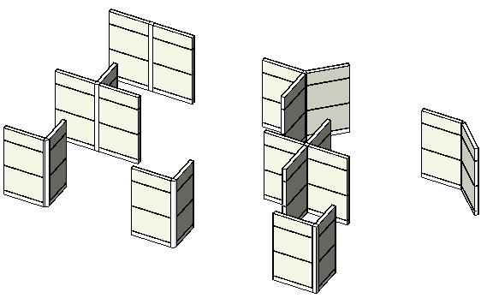
junctions
Junctions are placed separately
Junctions snap to start /end egdes of the panels

Slide 6
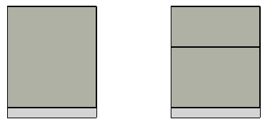
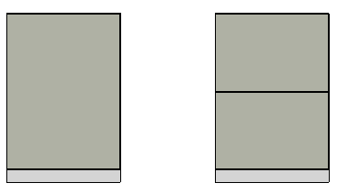
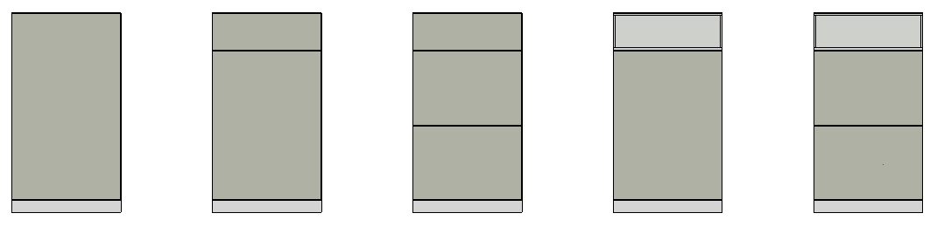
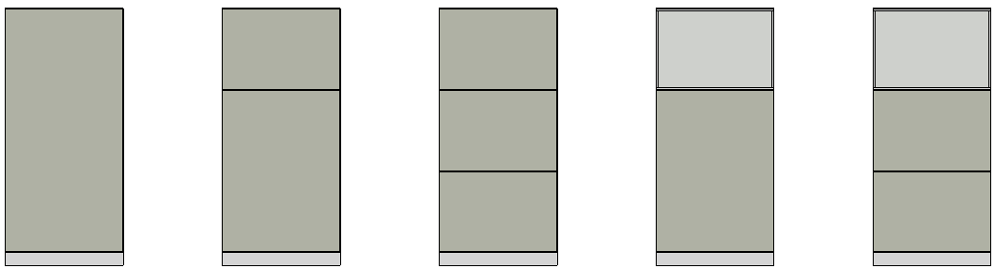
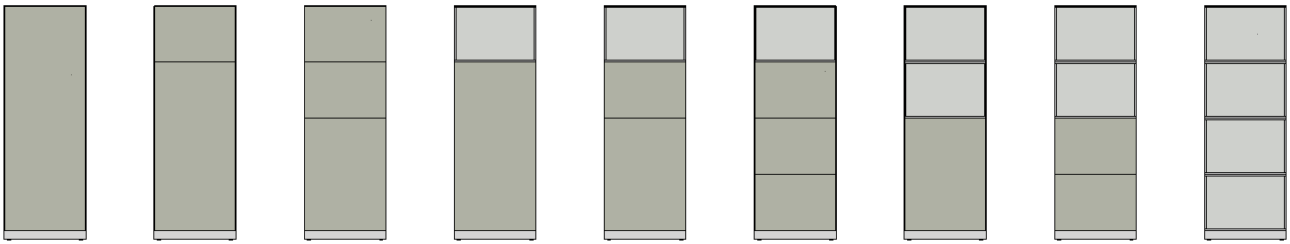
implemented tile front / tile back arrangements
38"H panels
45"H panels
40+10
20+20+10
40+G10
55"H panels
50
20+20+G10
65"H panels
86"H panels

Slide 7
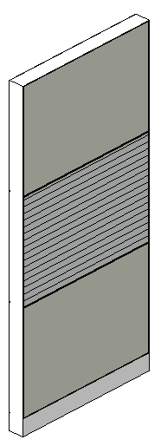
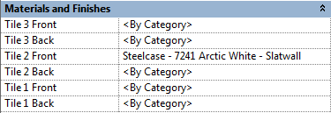
element properties
3 Front
2 Front
1 Front
3 Front
2 Front
1 Front

Slide 8
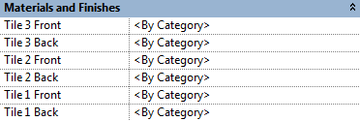
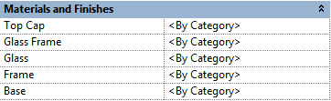
element properties
Sample: Steelcase - Montage - Frame - 65''H - Enhanced Monolithic - Base Cavity
Materials can be assigned for each single tile.
This includes wood, laminate, steel and slatwall tiles.
The materials for window frame and glass are available as type properties, as with frame, base and top cap materials.

Slide 9
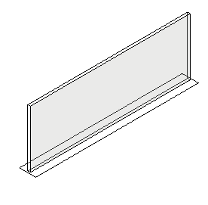
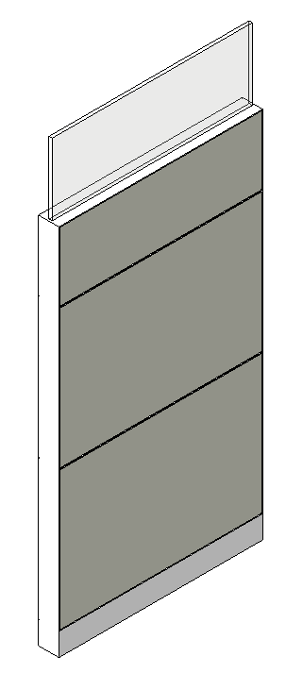
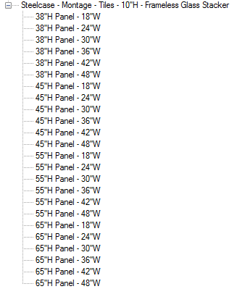
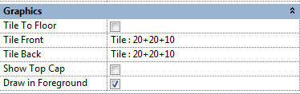
glass stackers
Glass stackers are separate families.They can be loaded and placed separately on top of the panel, using the appropriate type. Each type contains the correct default elevation.
Disable „Show Top Cap“ for the panel in Element Properties.

Slide 10
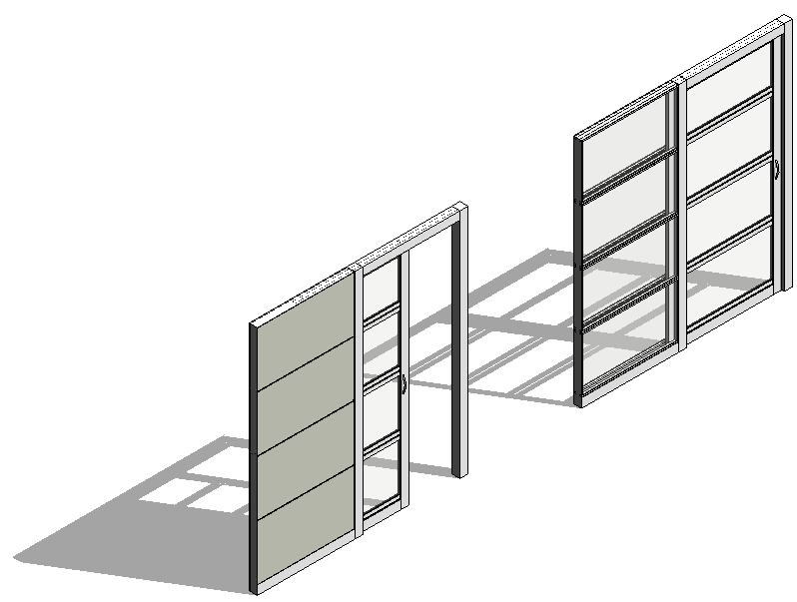
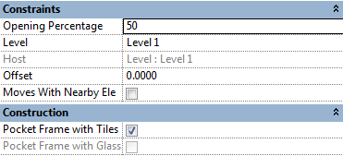
pocket doors
Opening Percentage: 0
Pocket Frame with Glass
Opening Percentage: 50
Pocket Frame with Tiles
For Pocket Doors, use the Opening Percentage parameter in Element Properties to display the door opened or closed.
You can define the Pocket Frame with Glass Tile Packages or with Tiles in Element Properties.

