Slide 1

Answer
Junction & Trim
for Revit Families

Slide 2
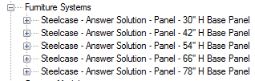

basics
Only base panels are available.
Each height represents 1 family.
Each width represents 1 type.
Intention of the families is to create layouts with nested families instead of arranging frames, junctions, skins individually.
Style Number only for single items available, not for panel families.

Slide 3
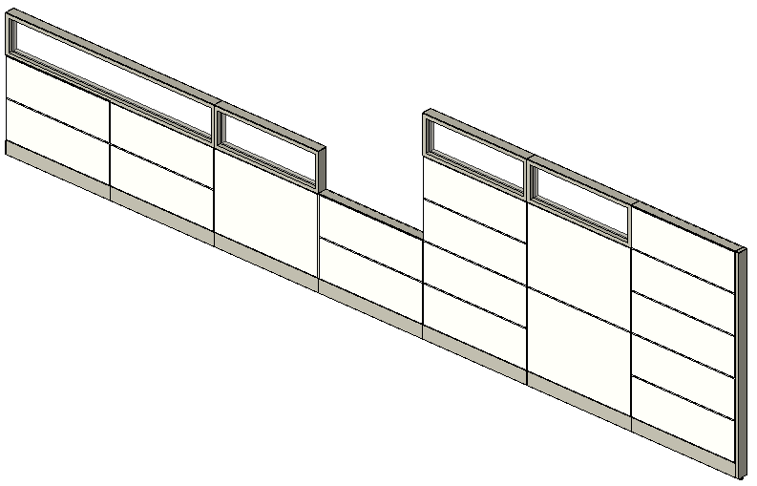
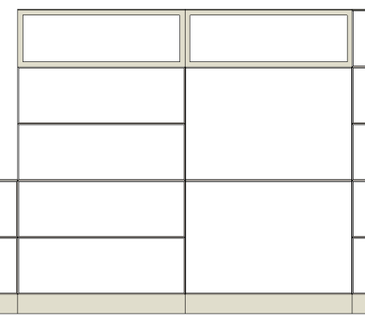
dimensions
Panel Heights
30"H 30.25
42"H 42.25
48‘‘H 48.25
54"H 54.25
66"H 66.25
78"H 78.25

Slide 4

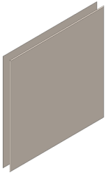

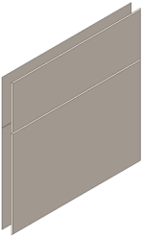

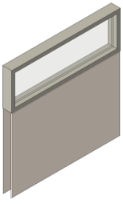

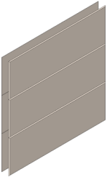
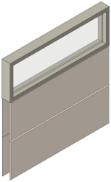
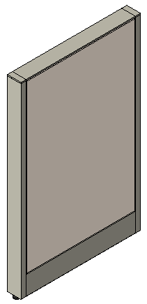
nested families (1)
Sample: Steelcase - Answer Solution - Panel - 42'' H Base Panel
JUNCTION Family
None
End-of-Run - Square
L Junction - Square
Y Junction - Square
T Junction - Square
In-Line - Square
X Junction - Square
V Junction – Square
End-of-Run - Thin
L Junction - Thin
Y Junction - Thin
T Junction - Thin
In-Line - Thin
X Junction - Thin
V Junction - Thin
SKIN Family
(contains all Skin arrangements)
12+12+12
12+12+12G
36
24+12
24+12G
(note: ″G ″ stands for Glass Windows)

Slide 5
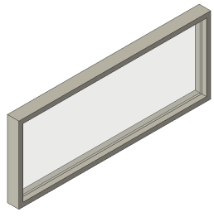
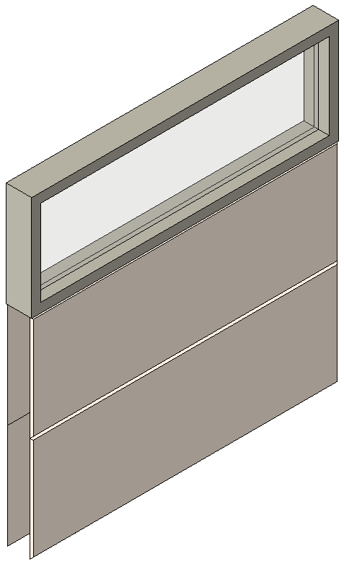
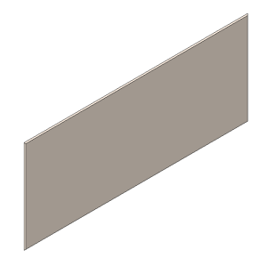
nested families (2)
Sample: 12+12+12G Window.rfa for 42‘‘H Base Panels
Window and Panel are nested into the skin arrangement families.

Slide 6
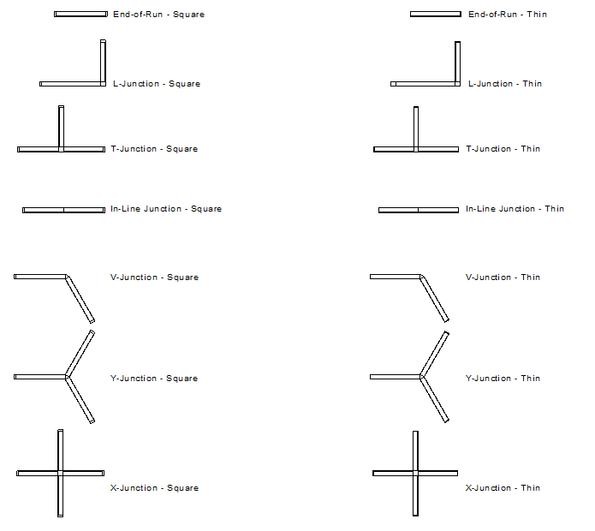
element properties

Slide 7
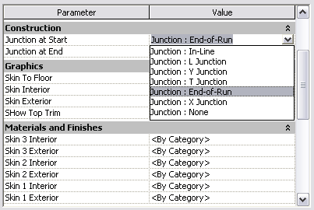
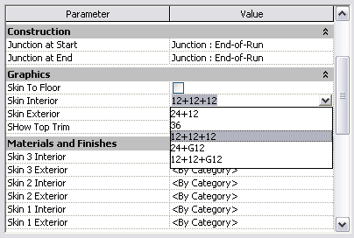
element properties
selection of start & end junctions
selection of skin arrangements

Slide 8

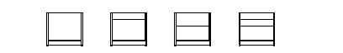
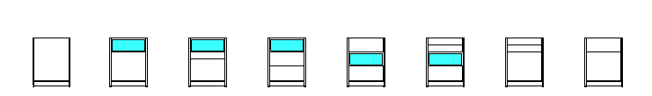
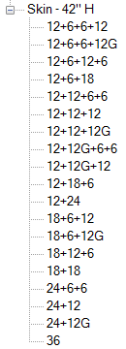
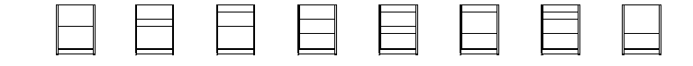

implemented skin arrangements
30‘‘ H Panel
42‘‘ H Panel

Slide 9
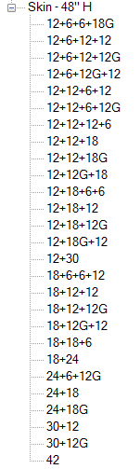
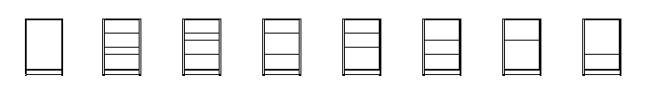
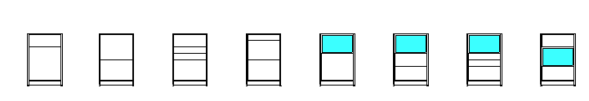
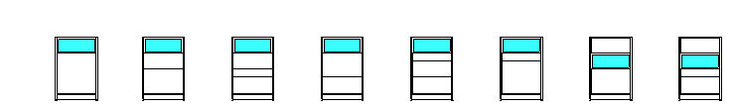
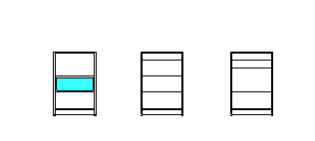
implemented skin arrangements
48‘‘ H Panel

Slide 10
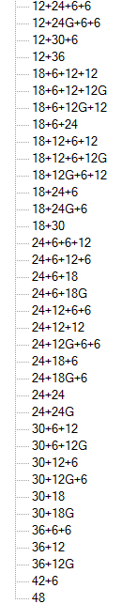
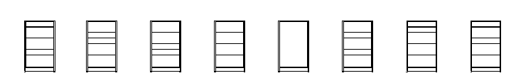
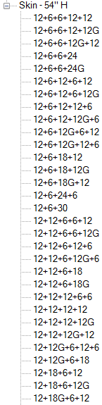
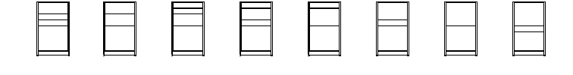
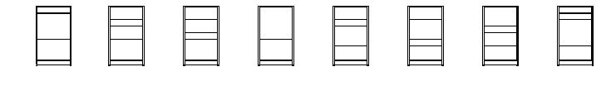

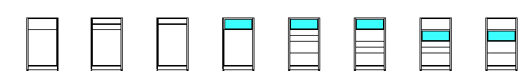
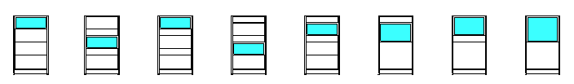
implemented skin arrangements
54‘‘ H Panel

Slide 11

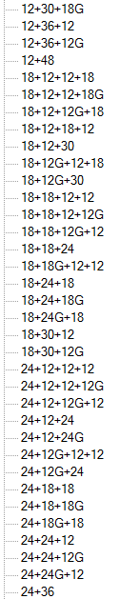
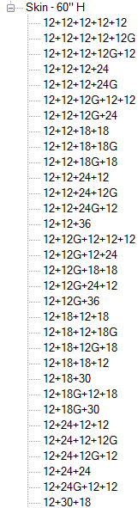
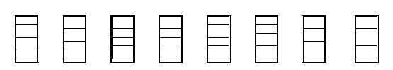
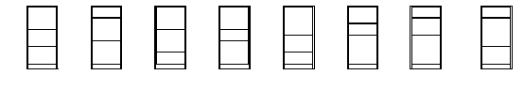




implemented skin arrangements
66‘‘ H Panel

Slide 12
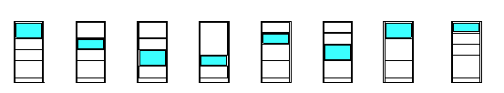
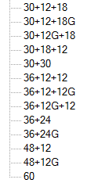

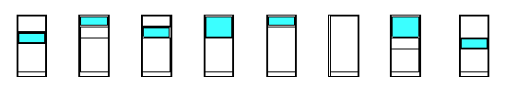
implemented skin arrangements
66‘‘ H Panel- cont.

Slide 13
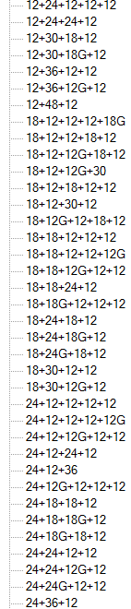
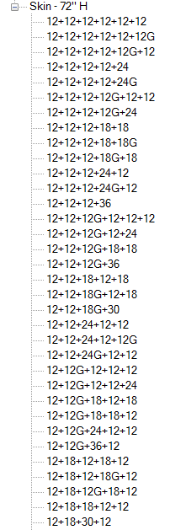




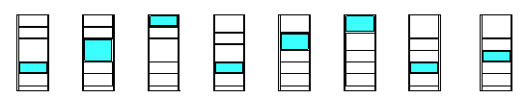
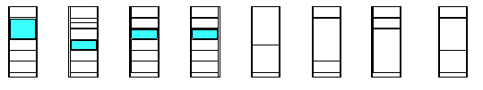
implemented skin arrangements
78‘‘ H Panel

Slide 14

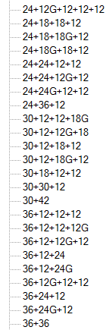
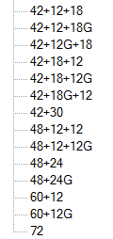
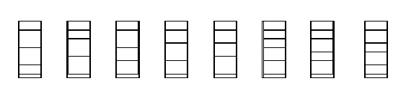
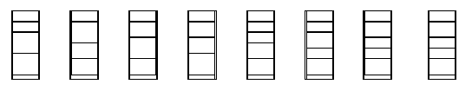
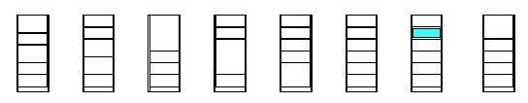
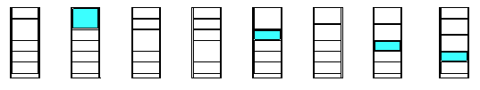
implemented skin arrangements
78‘‘ H Panel – cont.

Slide 15
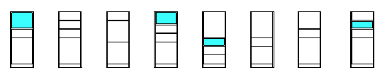
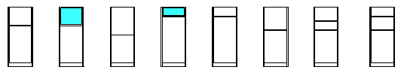

implemented skin arrangements
78‘‘ H Panel – cont.

Slide 16


element properties
3 Interior
2 Interior
1 Interior
3 Exterior
2 Exterior
1 Exterior

Slide 17


element properties
Sample: Steelcase - Answer Solution - Panel - 42'' H Base Panel
Materials can be assigned for each single panel.
This includes wood, laminate, steel and slatwall panels.
The materials for frame and glass are available as type properties, as with base trim and top trim materials.

Slide 18




window spanning two panels
Use Offset Parameters in Element Properties, disable „“Show Top Trim“ Parameter
End-of-run junction placed separately at the end of the panel.
Note: For special conditions, a separate junction family is available

Slide 19



top screens
Top screens are separate families.
They can be loaded and placed separately on top of the panel, using the appropriate type. Each type contains the correct default elevation.

Slide 20



change-of-height trim
Change-of-height trims can be placed separately.
NOTE: Only sample types are currently implemented

Slide 21


technology openings
Technology Openings can be enabled in Element Properties under the Electrical group for the 2nd and 3rd panel.
They reflected the Spec Guide rules. EXCEPTION: The user is responsible, that they show only on 12‘‘H panels.

Slide 22


plan views
coarse
medium/fine

